Slide 1

Representation Learning on Networks
Jure Leskovec, William L. Hamilton, Rex Ying, Rok Sosic
Stanford University

Slide 2
Why networks?
Networks are a general language for describing and modeling complex systems

Slide 4
Network!

Slide 5
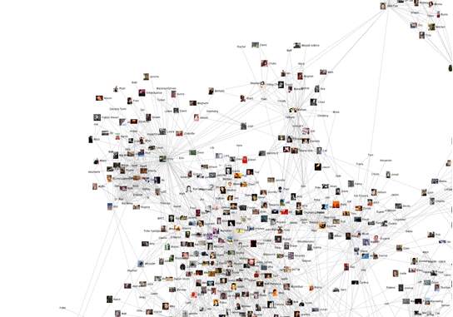
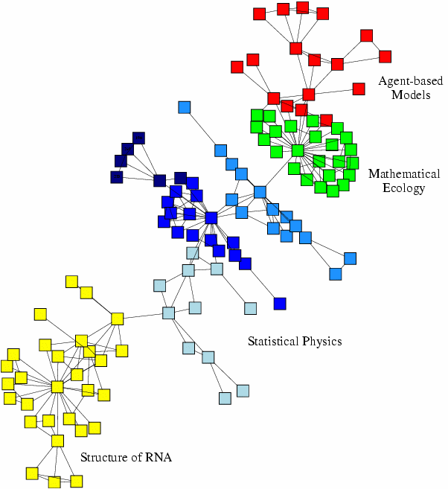
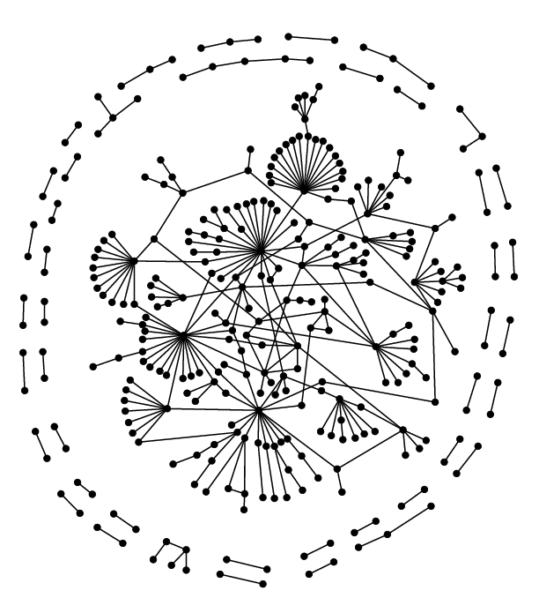
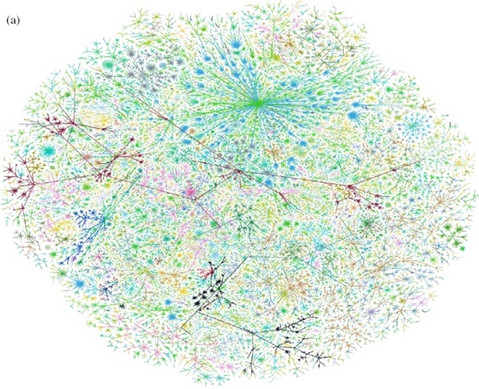
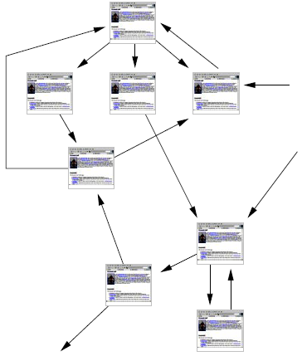
Many Data are Networks
Social networks
Economic networks
Biomedical networks
Information networks: Web & citations
Internet
Networks of neurons

Slide 6
Why Networks? Why Now?
Universal language for describing complex data
Networks from science, nature, and technology are more similar than one would expect
Shared vocabulary between fields
Computer Science, Social science, Physics, Economics, Statistics, Biology
Data availability (+computational challenges)
Web/mobile, bio, health, and medical
Impact!
Social networking, Social media, Drug design

Slide 7
Machine Learning with Networks
Classical ML tasks in networks:
Node classification
Predict a type of a given node
Link prediction
Predict whether two nodes are linked
Community detection
Identify densely linked clusters of nodes
Network similarity
How similar are two (sub)networks

Slide 8
Example: Node Classification
?
?
?
?
Machine Learning
?

Slide 9
Example: Node Classification
Classifying the function of proteins in the interactome!
Image from: Ganapathiraju et al. 2016. Schizophrenia interactome with 504 novel protein–protein interactions. Nature.

Slide 10
Example: Link Prediction
?
?
x
?
Machine Learning

Slide 11








Example: Link Prediction
Content recommendation is link prediction!
?

Slide 12
Machine Learning Lifecycle
(Supervised) Machine Learning Lifecycle: This feature, that feature. Every single time!
Raw Data
Structured Data
Learning Algorithm
Model
Feature Engineering
Automatically learn the features
Downstream prediction task

Slide 13
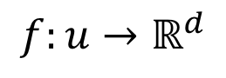
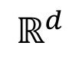
Feature Learning in Graphs
Goal: Efficient task-independent feature learning for machine learning in networks!
node
2
vec
u
$$f:u→ℝ^{d}$$
$$ℝ^{d}$$
Feature representation, embedding

Slide 14
Example
Zachary’s Karate Club Network:
Input
Output
Image from: Perozzi et al. 2014. DeepWalk: Online Learning of Social Representations. KDD.

Slide 15
Why Is It Hard?
Modern deep learning toolbox is designed for simple sequences or grids.
CNNs for fixed-size images/grids….
RNNs or word2vec for text/sequences…

Slide 16
Why Is It Hard?
But networks are far more complex!
Complex topographical structure (i.e., no spatial locality like grids)
No fixed node ordering or reference point (i.e., the isomorphism problem)
Often dynamic and have multimodal features.

Slide 17
This talk
1) Node embeddings
Map nodes to low-dimensional embeddings.
2) Graph neural networks
Deep learning architectures for graph-structured data
3) Applications

